Slide 1
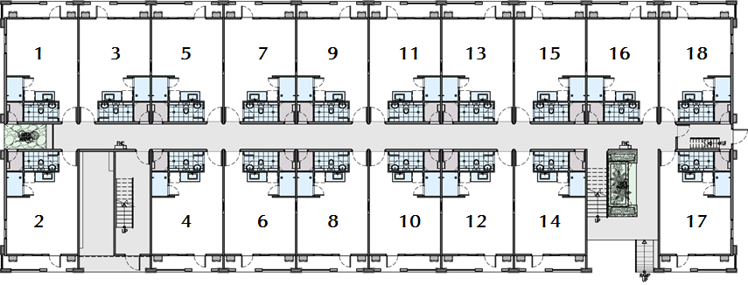
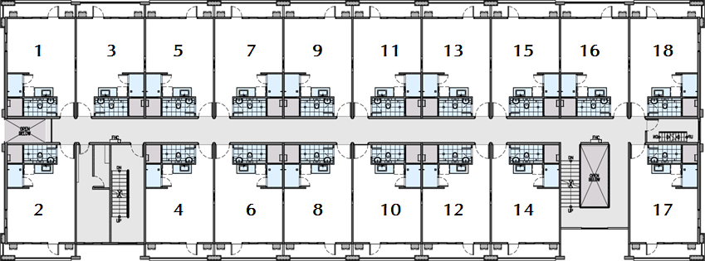
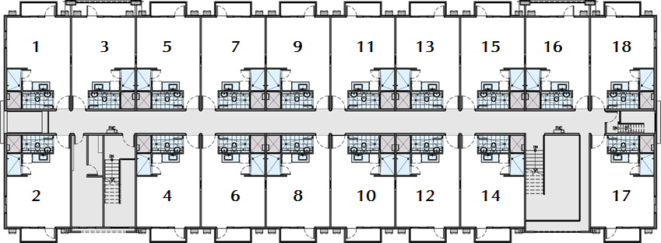
Building Floor Plan
2, 3, 5, 6 and 9
Ground Floor
2nd and 3rd Floor
4th and 5th Floor
INFORMATION AS May 14, 2014
The developer reserves the right to change, alter and /or improve specifications and details appearing herein without prior notice. The information in this material is for identification and reference purposes only and does not authorize any person to render any representation or warranty regarding this project.

Slide 2
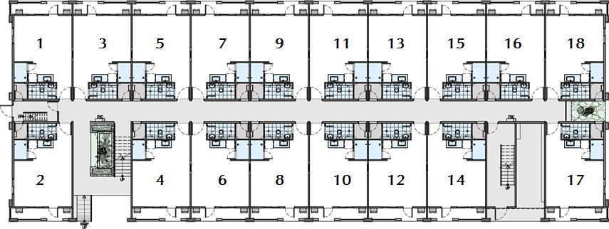
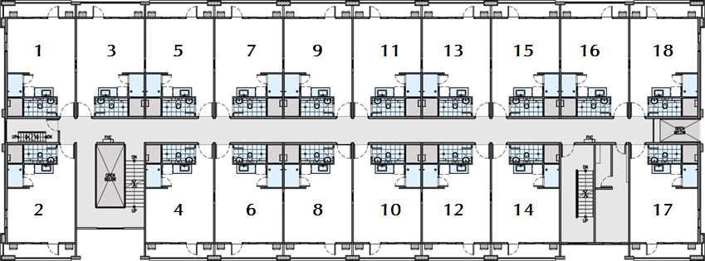
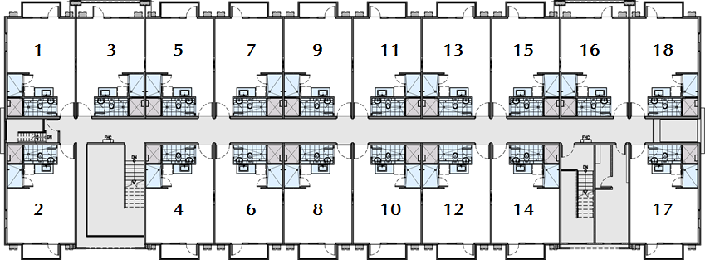
Building Floor Plan
1, 4, 7, 8 and 10
Ground Floor
2nd and 3rd Floor
4th and 5th Floor
INFORMATION AS May 14, 2014
The developer reserves the right to change, alter and /or improve specifications and details appearing herein without prior notice. The information in this material is for identification and reference purposes only and does not authorize any person to render any representation or warranty regarding this project.

Slide 3
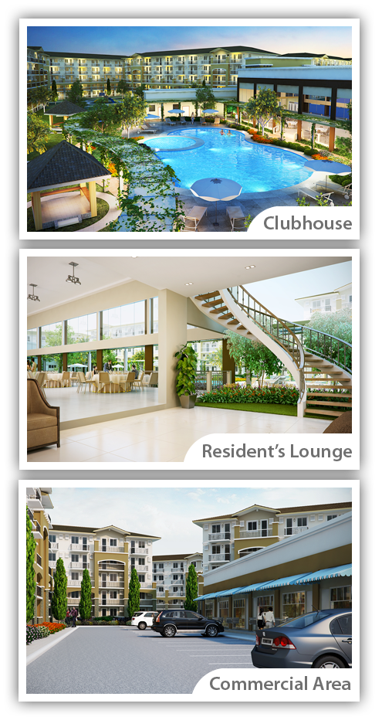
Enjoy Amenities at Piazza
Main multi-purpose function hall
Resident’s lounge
Adult swimming pool
Children's swimming pool
Covered walkway along pool area
Landscaped gardens
Children's playground
Basketball court
Gazebos
Function room
INFORMATION AS May 14, 2014
The developer reserves the right to change, alter and /or improve specifications and details appearing herein without prior notice. The information in this material is for identification and reference purposes only and does not authorize any person to render any representation or warranty regarding this project.

Slide 4
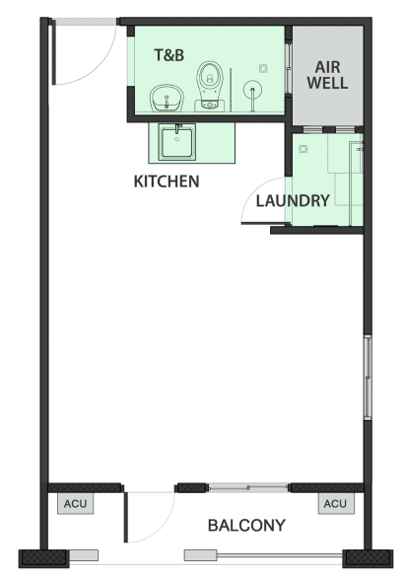
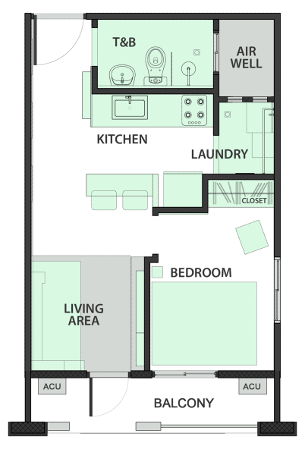
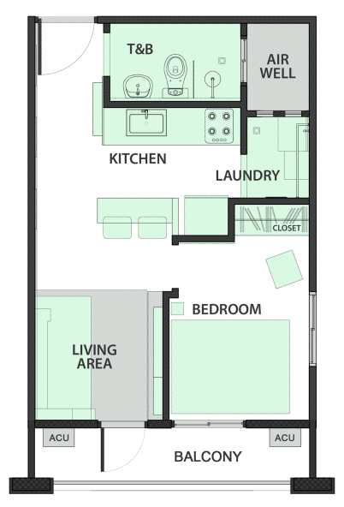
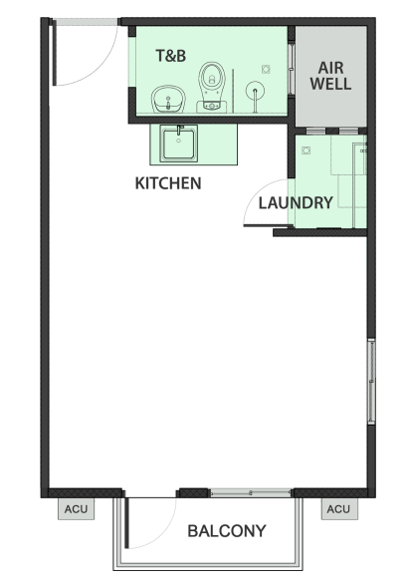
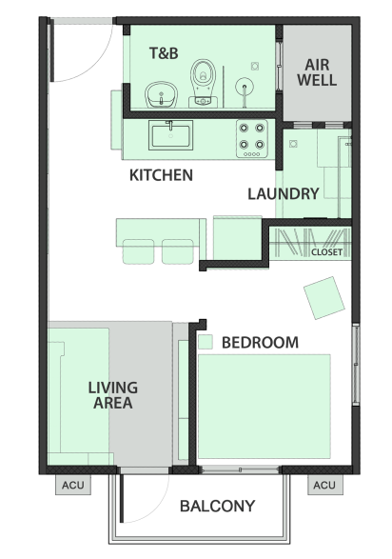
Typical Ground Floor Unit
32.5sqm
Typical 2nd & 3rd Floor Unit
32.5sqm
Typical 4th and 5th Floor Unit
30.6sqm
INFORMATION AS SEPT 26, 2013. HLURB LTS#: 26915
The developer reserves the right to change, alter and /or improve specifications and details appearing herein without prior notice. The information in this material is for identification and reference purposes only and does not authorize any person to render any representation or warranty regarding this project.

Slide 5
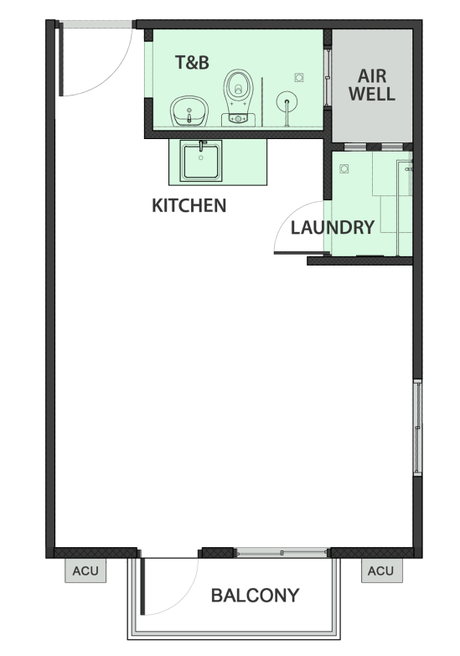
Unit Features and Finishes
Typical 30.6sqm Turnover Unit
Suggested Layout 30.6sqm Unit
Walls & Ceiling | Painted finish
Floors | Vinyl floor planks
T&B | Plumbing fixtures & ceramic tiles (1.2m from the floor)
Kitchen | Modular kitchen w/ granite counter top
Windows | Powder coated sliding aluminum windows
Doors | Fire rated steel door with peephole
Provisions | Space for two window-type ACU opening
 | Telephone, cable TV and internet connection
Fire Safety | Smoke detector and sprinkler system
Electrical | Lighting, switches and receptacles, ACU power outlets
Laundry Area | 1.5sqm
Balcony | 4.5sqm on ground floor units
 | 2.6sqm to 4.5sqm on upper floor units
Ceiling Height | 2.4m
INFORMATION AS SEPT 26, 2013. HLURB LTS#: 26915
The developer reserves the right to change, alter and /or improve specifications and details appearing herein without prior notice. The information in this material is for identification and reference purposes only and does not authorize any person to render any representation or warranty regarding this project.

Slide 6
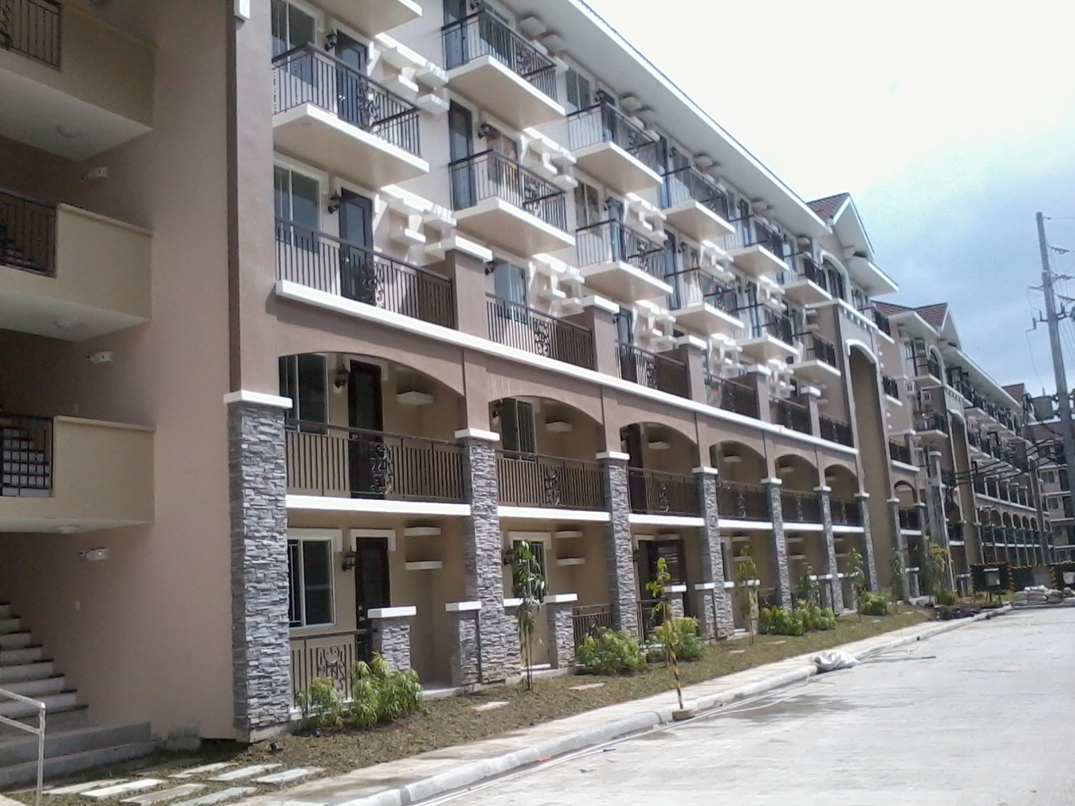
Building Features
Low density 5-storey walkup type
90 units per building
30.6 to 32.5sqm units
Exclusive sky-lit atrium per building
Fire alarms and sprinkler system
Fire-hose cabinets on every floor
Ramp for people with disabilities
Emergency lights for common areas
INFORMATION AS SEPT 26, 2013. HLURB LTS#: 26915
The developer reserves the right to change, alter and /or improve specifications and details appearing herein without prior notice. The information in this material is for identification and reference purposes only and does not authorize any person to render any representation or warranty regarding this project.

Slide 7
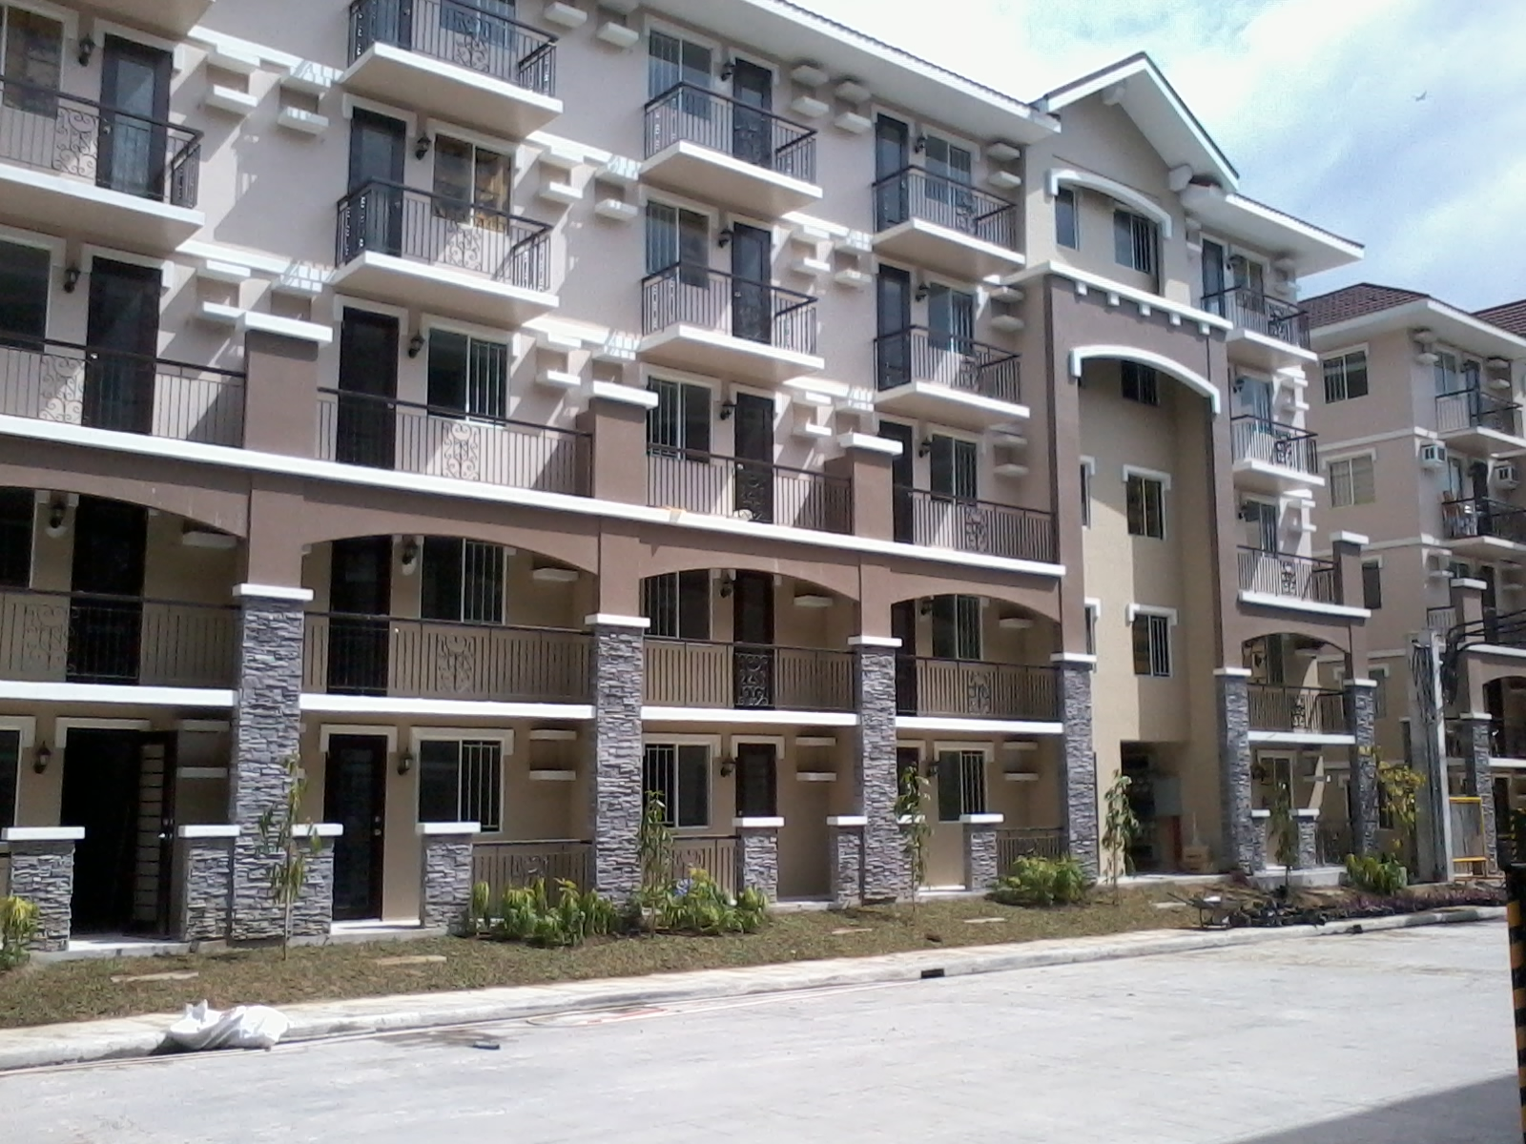
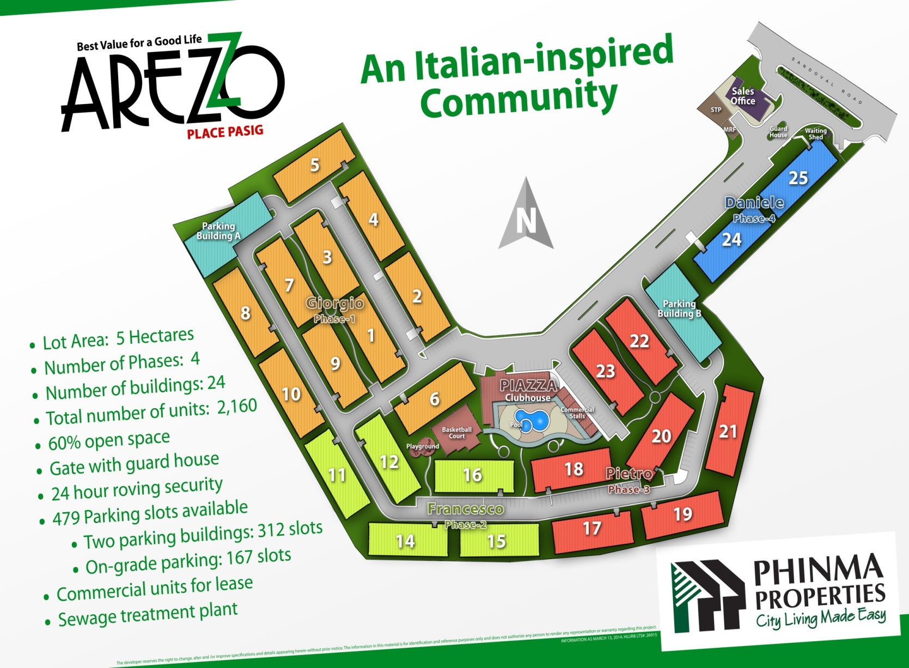
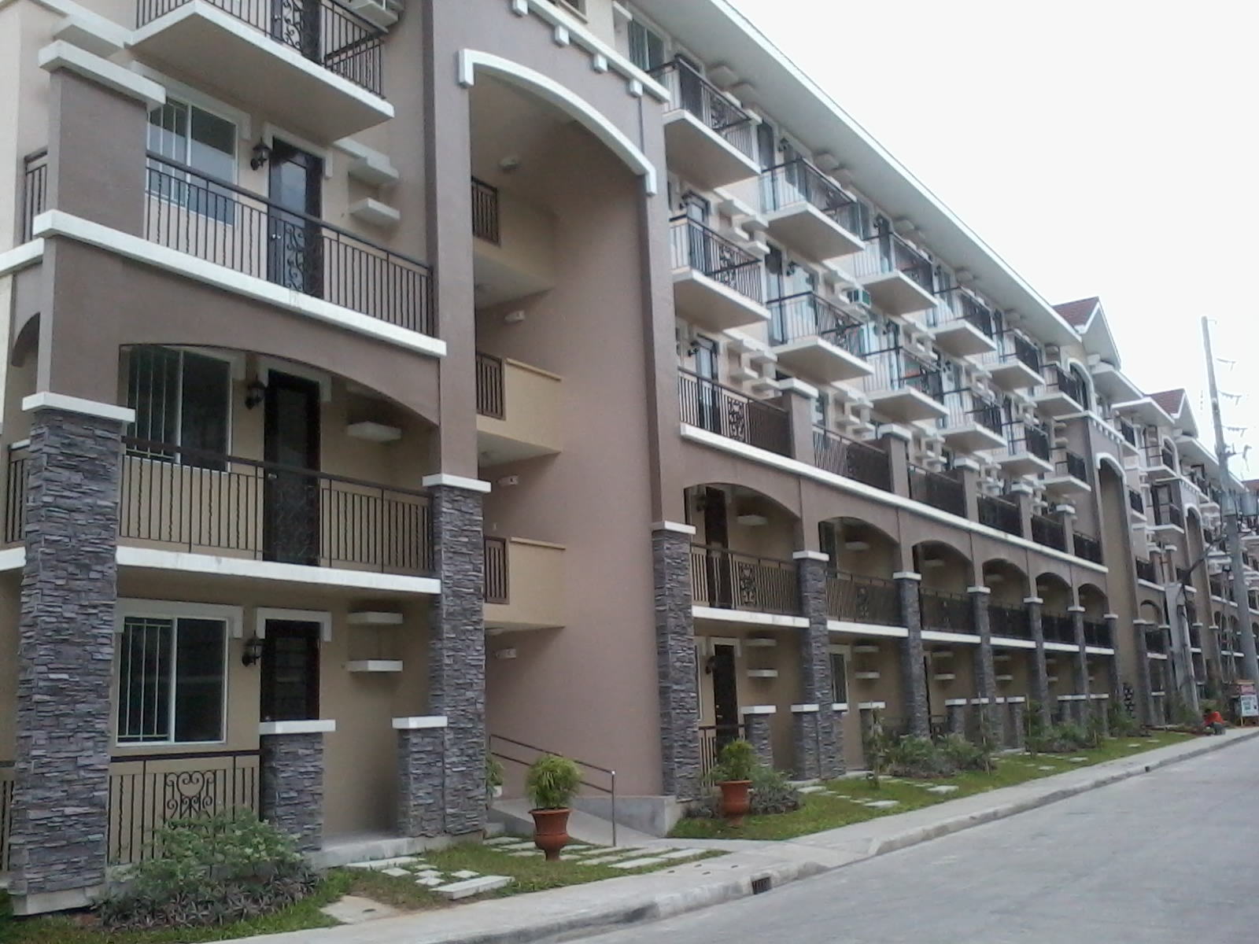
An Italian-inspired Community
7
1
Gate with guard house
24-hour roving security
479 Parking slots available
Two parking buildings: 312 slots
On-grade parking: 156 slots
Commercial units for lease
Sewage treatment plant
INFORMATION AS SEPT 26, 2013. HLURB LTS#: 26915
The developer reserves the right to change, alter and /or improve specifications and details appearing herein without prior notice. The information in this material is for identification and reference purposes only and does not authorize any person to render any representation or warranty regarding this project.
Notes:
Make Phase 2 3 4 grass area.
Remove parking buildings
Add for future developments
Show Phase1 and Piazza and gate and sales office
Change a. Sandoval to Alfonso Sandoval Ave

Slide 8
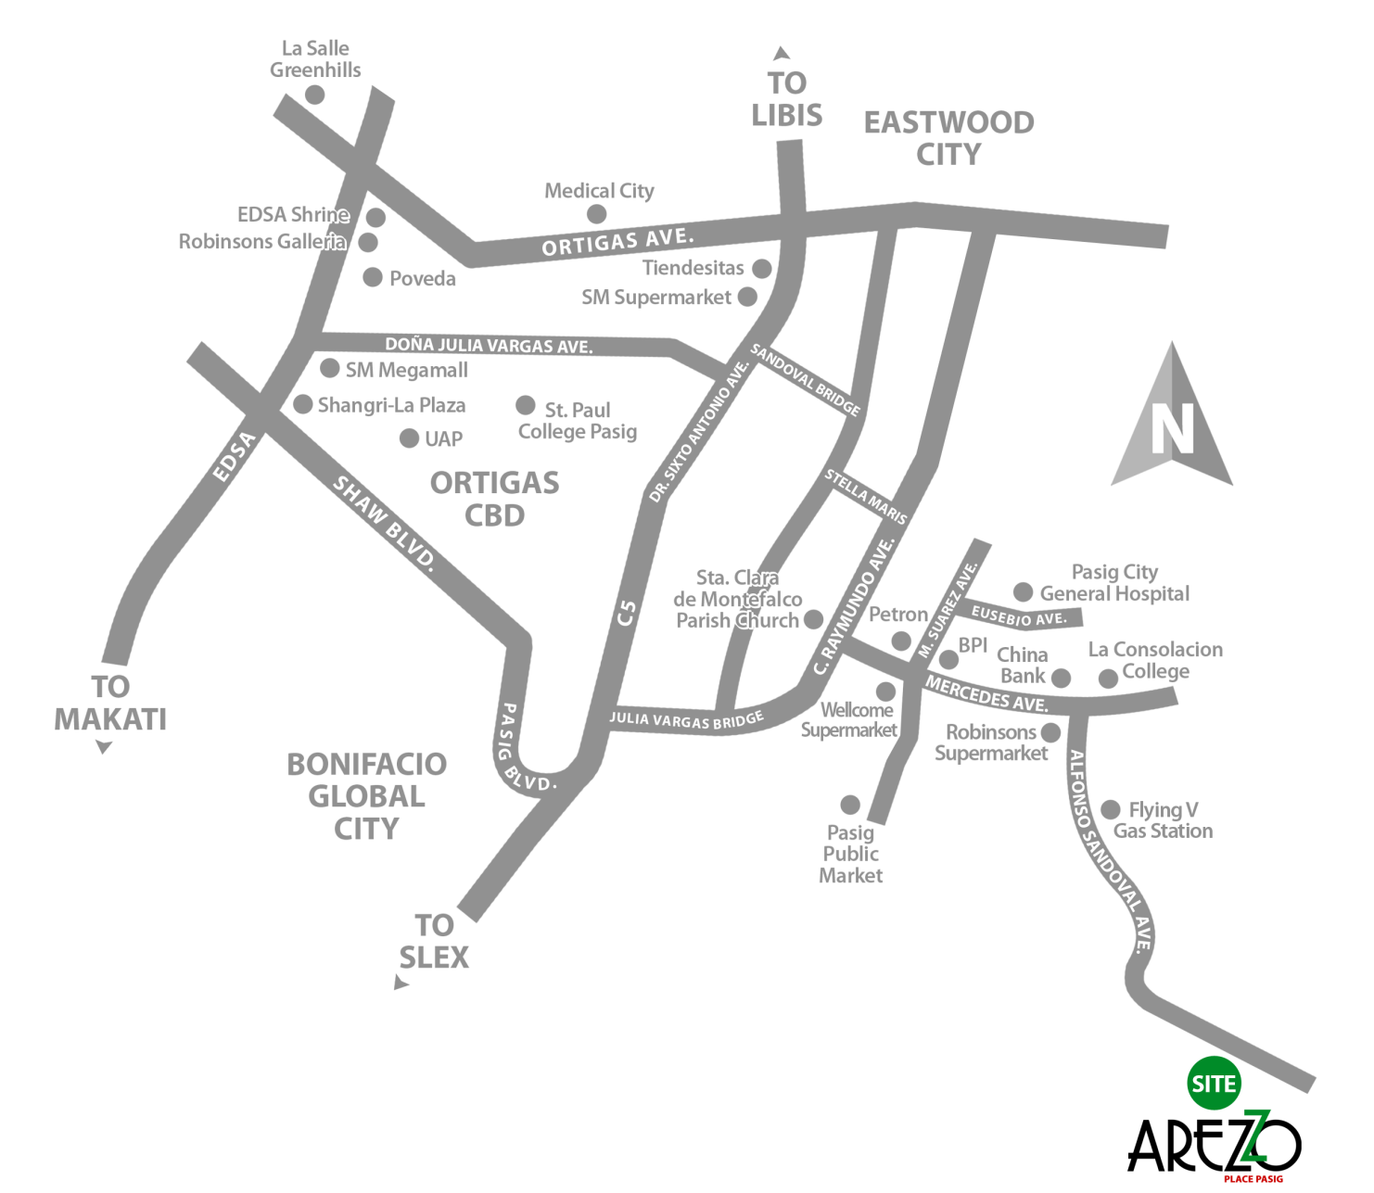
Nestled in the prime urban location city of Pasig along Alfonso Sandoval, Pasig City, few minutes away from Mercedes Avenue.
Accessible via C5 connecting to the Makati, Ortigas, Eastwood and Taguig business centers
Locations
HOSPITALS
Rizal Medical Center 3.6km Pasig City General Hospital 3.7km
The Medical City 8.7km
PROMINENT BUSINESS CENTERS
Ortigas Center 9 km
Eastwood City 9 km
SCHOOLS
La Consolacion College Pasig 2.3 km
Pasig Catholic College 3.6 km
St. Paul College 7.9 km
University of Asia & the Pacific 8.3km
COMMERCIAL ESTABLISHMENTS
Robinson’s Supermarket 2.3km
Pasig Public Market 2.6km
Wellcome Supermarket 3km
Tiendesitas 7.4km
Eastwood Mall 9km
SM Megamall 9.2 km
Robinson's Galleria 10 km
INFORMATION AS SEPT 26, 2013. HLURB LTS#: 26915
The developer reserves the right to change, alter and /or improve specifications and details appearing herein without prior notice. The information in this material is for identification and reference purposes only and does not authorize any person to render any representation or warranty regarding this project.

Slide 9
For inquiries please contact:

